Slide 1
Big Data Hadoop and Spark Developer

Slide 2
Spark SQL and DataFrames

Slide 3

Identify the importance and features of Spark SQL
Convert RDDs to DataFrames
Load data through different sources
Illustrate user-defined functions
Interoperate with RDDs

Slide 4
Spark SQL Introduction

Slide 5

Spark SQL
It is a module for structured data processing that is built on top of Spark Core.
The Spark SQL module provides an abstraction called DataFrame, which simplifies the process of working with structured datasets.
It supports multiple programming languages, such as Java, R, Python, and Scala.
It provides row-level updates and real-time online transaction processing.
Notes:
Trainer Notes:
Explain the diagram given.

Slide 6
Need for Spark SQL
Spark SQL was created to overcome the limitations of Apache Hive.
It was released in 2014.
It is built on top of the Spark Core module.
It can integrate with NoSQL databases, but it primarily works with RDBMS.

Slide 7

Limitations of Apache Hive
Apache Hive uses MapReduce as the execution engine which leads to lags in performance.
Real-time online transactional processing (OLTP) queries are not possible in Hive.
Row-level updates are not possible in Hive.
Hive cannot drop encrypted databases.

Slide 8

Limitations of Apache Hive
It executes faster as it has in-memory computation.
It can run Hive queries as it has no migration issues.
Real-time querying is possible with Spark SQL.
It has the capability to interact with Hive metastore.

Slide 9
Limitations of Apache Hive
Mixes SQL queries with Spark programs
Provides standard connectivity with the help of JDBC or ODBC
Executes the optimal plan for better performance
Supports multiple file formats, such as CSV, Parquet, and Avro

Slide 10
Spark SQL Architecture

Slide 11
Spark SQL Architecture
Spark SQL consist of four libraries that deal with relational and procedural processing.
Data source API
DataFrame API
SQL service
DataFrame DSL

Slide 12





Spark SQL Architecture
DataFrame DSL
Spark SQL or HQL
DataFrame API
Data Source API
Notes:
Trainer Notes:
Data Source API=============🡺 Used to read and store structured data and semi-structured data in Spark SQL.Data Source API can load files from multiple file formats.
Data Frame API=============🡺Dataframe API converts the data that is read through Data Source API into tabular columns. Dataframe is a distributed collection of data organized into named columns. Tabular columns helps in performing SQL operations.
SQL Service===========SQL Service is the entry point for working along with Structured data in Apache Spark.SQL service is used to fetch the result from interpreted and optimized data.
Dataframe DSL ==========🡺 DataFrame is a data abstraction or a domain-specific language (DSL) for working with structured and semi-structured data, i.e. datasets that you can specify a schema for. DataFrame is a collection of rows with a schema that is the result of executing a structured query (once it will have been executed).

Slide 13

Spark SQL Architecture
Data Source API
It helps one read and store structured and semi-structured data in Spark SQL. Data Source API can load files from multiple file formats.
DataFrame API
It converts the data into tabular columns that can be read using Data Source API.
DataFrame is a distributed collection of data organized into named columns. Tabular columns helps perform SQL operations.
SQL service
SQL service is the entry point for working with structured data in Apache Spark.
It is also used to fetch the result from interpreted and optimized data.
DataFrame DSL (domain specific language)
DataFrame DSL is a collection of rows with a schema, which is a result of executing structured query.
Notes:
Trainer Notes:
Data Source API=============🡺 Used to read and store structured data and semi-structured data in Spark SQL.Data Source API can load files from multiple file formats.
Data Frame API=============🡺Dataframe API converts the data that is read through Data Source API into tabular columns. Dataframe is a distributed collection of data organized into named columns. Tabular columns helps in performing SQL operations.
SQL Service===========SQL Service is the entry point for working along with Structured data in Apache Spark.SQL service is used to fetch the result from interpreted and optimized data.
Dataframe DSL ==========🡺 DataFrame is a data abstraction or a domain-specific language (DSL) for working with structured and semi-structured data, i.e. datasets that you can specify a schema for. DataFrame is a collection of rows with a schema that is the result of executing a structured query (once it will have been executed).

Slide 14
Spark Session and SparkContext

Slide 15
SparkContext
It is the main entry point to Spark functionality, which provides internal services and establishes a connection to a Spark execution environment.
Executor
Cache
Task
Task
Application
Driver Program
Cluster Manager
Worker Node
SparkContext
Executor
Cache
Task
Task
Worker Node
Notes:
Trainer Notes:
Explain the Diagram with components.

Slide 16
SparkContext
It can be used to create RDDs, accumulators, and broadcast variables to access Spark services and to run jobs till SparkContext is terminated.
It needs separate contexts to be created in order to use APIs of SQL, Hive, and Streaming.
It deals with the versions prior to 2.0.0.
SparkContext

Slide 17
SQLContext in Spark SQL
It is the main entry point for DataFrame and SQL functionality. It is used to create DataFrames, register DataFrames as tables, execute SQL over tables, cache tables, and read Parquet files.
Class pyspark.sql.SQLContext(sparkContext, sqlContext=None)
Sample Code:
>>> l = [('Alice', 1)]
>>> sqlContext.createDataFrame(l).collect()
Output:[Row(_1=u'Alice', _2=1)]
>>> sqlContext.createDataFrame(l, ['name', 'age']).collect()
Output:[Row(name=u'Alice', age=1)]
Notes:
Parameters:
sparkContext – The SparkContext backing this SQLContext.
sqlContext – An optional JVM Scala SQLContext. If set, we do not instantiate a new SQLContext in the JVM, instead we make all calls to this object.

Slide 18
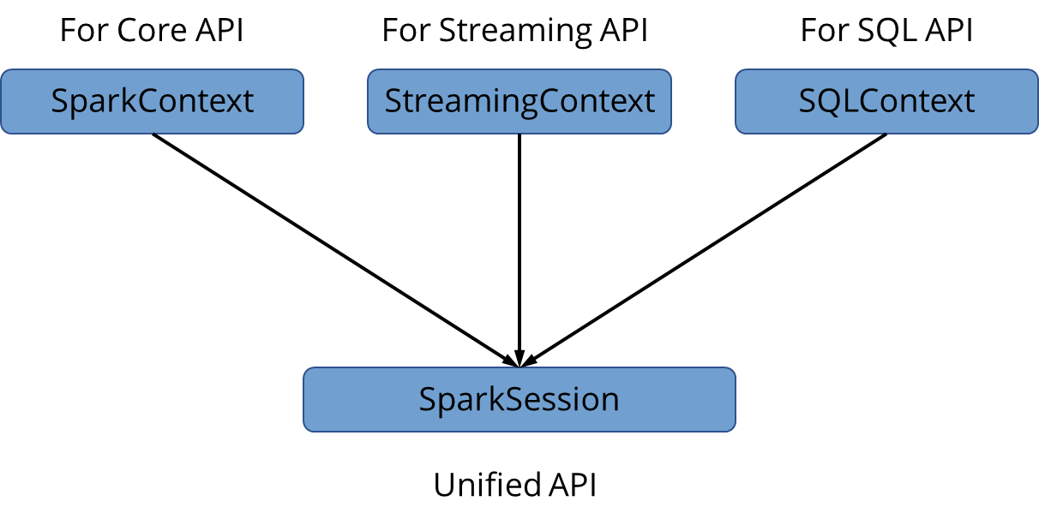
SparkSession
It provides a single point of entry to interact with the underlying Spark functionality and allows one to program Spark with DataFrame and Dataset APIs. All the functionalities available in SparkContext are also available in SparkSession.

Slide 19
SparkSession
Deals with all versions after 2.0.0
Configures Spark run-time configuration properties once the SparkSession is instantiated
Includes all the APIs eliminating the need to create separate contexts
SparkSession

Slide 20
Unified SparkSession
The SparkSession class is the starting point for all Spark functionality. To create a basic SparkSession, SparkSession.builder is used:
class pyspark.sql.SparkSession(sparkContext,jsparkSession=None)
//SparkSession uses the following builder pattern.
Code Snippet:
from pyspark.sql import SparkSession
spark = SparkSession\
.builder\
.appName("Demo")\
.config("config.name", "config.value")\
.getOrCreate()

Slide 21
SchemaRDDs
SchemaRDD is a collection of row objects along with a schema. A schema defines the data types of each column in the row. A SchemaRDD can be created from:
Existing RDD
JSON dataset
Parquet File
Running HiveQL on Hive Database

Slide 22
SchemaRDDs Instance Methods
saveAsParquetFile(self, path)
registerTempTable(self, name)
Code Snippet:
Code Snippet:
>>> srdd = sqlCtx.inferSchema(rdd)
>>> srdd.registerTempTable("
>>> import tempfile, shutil
>>> parquetFile = tempfile.mkdtemp()
>>> shutil.rmtree(parquetFile)
>>> srdd = sqlCtx.inferSchema(rdd)
>>> srdd.saveAsParquetFile(parquetFile)

Slide 23
User-Defined Functions

Slide 24
User-Defined Functions (UDFs)
Allows to register a custom function and use the same
within SQL
Well-created UDFs avoid performance issues
User-Defined Functions
Provides advanced functionality that is not present in the
in-built functions
Supports existing Apache Hive User-Defined functions

Slide 25
Registering a function as UDF
Create a function to convert a string to uppercase
Register function as UDF
spark.udf.register(“to_upper", uppercase, StringType())
Code Snippet:
def to_uppercase(str):
resStr=""
arr = str.split(" ")
for x in arr:
resStr= resStr + x[0:1].upper() + x[1:len(x)] + " "
return resStr

Slide 26
UDF with DataFrame
Create a function to convert a string to uppercase
C
Register function using UDF with DataFrame
Code Snippet:
Code Snippet:
def to_uppercase(str):
return resStr.upper()
df.select(col(“col1"), \
convertUDF(col(“col2")).alias(“uppercase_value"))\
.show(truncate=False)

Slide 27
User-Defined Aggregate Functions

Slide 28
User-Defined Aggregate Functions
Type | Value | Type Total
A | 3 | 15
A | 12 | 15
B | 7 | 9
B | 2 | 9
C | 9 | 20
C | 11 | 20
Spark SQL allows users to define custom aggregation functions called User-Defined Aggregate Functions or UDAFs.
UDAFs are very useful when performing aggregations across groups or columns.

Slide 29
User-Defined Aggregate Functions
To create a custom UDAF, it is required to extend UserDefinedAggregateFunction.
Syntax:
class GeometricMean extends UserDefinedAggregateFunction

Slide 30
Methods
Initialize
On a given node, this method is called once for each group.
Update
This method is called once for each group on a given node.
Spark will call update for each input record in a given group.
Merge
Spark computes partial aggregate results and combines them if the function supports partial aggregates
Evaluate
Spark will call evaluate to get the final result when all the entries for a group are exhausted.

Slide 31
Apache Spark DataFrames

Slide 32
DataFrames
DataFrames represent a distributed collection of data in which data is organized into named columns.
It was introduced in Spark 1.3 as an extension to RDDs.
It is a used for representing structured data in Spark.

Slide 33
DataFrames
It seems like a relational table in RDBMS but with richer optimizations under the hood.
Unlike RDDs, DataFrame keeps track of its schema.
DataFrame = RDD + Schema (SchemaRDD)
It supports various relational operations that lead to more optimized execution like Catalyst Optimizer.

Slide 34
DataFrames
Construct a DataFrame
Use sources such as tables in Hive, structured data files, existing RDDs, and external databases
Convert them to RDDs
Call the RDD method, which returns the DataFrame content, as an RDD of rows
In earlier versions of Spark SQL API, SchemaRDD has been renamed as DataFrame.
Notes:
Trainer Notes:
Explain both the points in detail.

Slide 35
Creating DataFrames
DataFrames can be created:
From an existing structured data source
From an existing RDD
By performing an operation or query on another DataFrame
By programmatically defining a schema

Slide 36
Spark DataFrames: Catalyst Optimizer

Slide 37
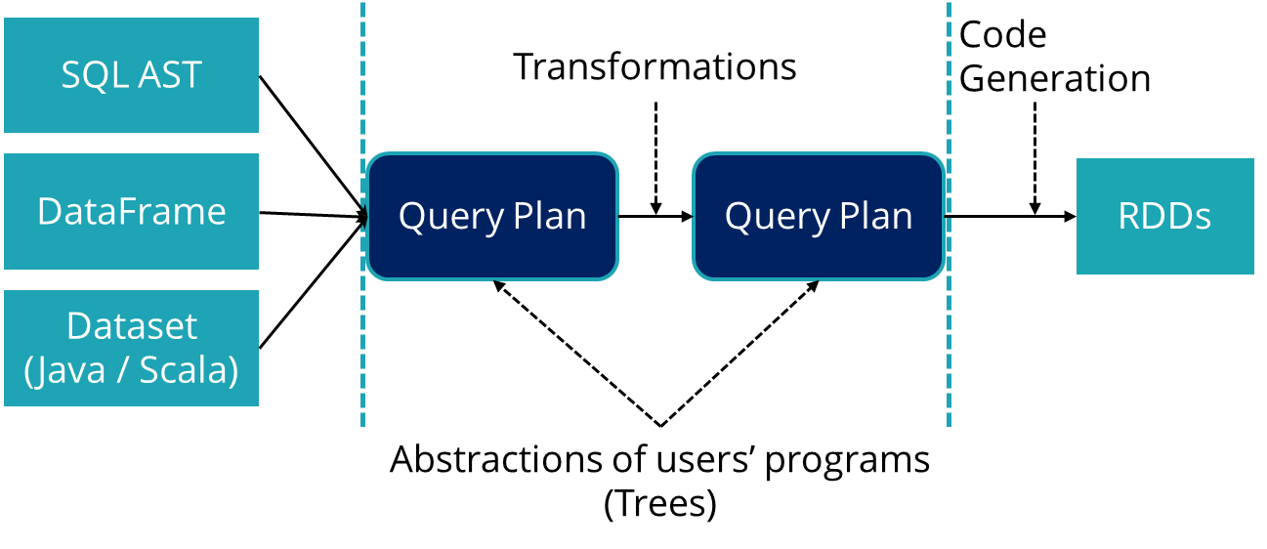
Catalyst Optimizer
The Catalyst optimizer is a component of Apache Spark, which optimizes structural queries written in SQL, DataFrame, or Dataset APIs.

Slide 38
Catalyst Optimizer
Catalyst Optimizer
It can reduce the runtime of programs and save costs.
It uses multiple techniques such as filtering and indexes.
It ensures that the data source joins are performed in the most efficient order.

Slide 39
Interoperating with RDDs

Slide 40
Interoperating with RDDs
To convert existing RDDs into DataFrames, Spark SQL supports three methods:
Using toDF()
Using createDataFrame()
Using RDD row type and schema

Slide 41
Create PySpark RDDs
Example:
from pyspark.sql import SparkSession
spark = SparkSession.builder.appName('Simplilearn’).getOrCreate()
emp = [(“Andrew",10),("Aiden",20),(“Michael",30),(“Stephan",40)]
rdd = spark.sparkContext.parallelize(emp)
for emp in rdd.collect():
print(emp)
Output:
(‘Andrew”, 10)
(‘Aiden”, 20)
(‘Michael”, 30)
(‘Stephan”,40)
RDD

Slide 42
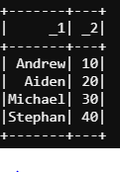
Convert PySpark RDDs to DataFrame Using toDF()
Example:
empDF = rdd.toDF()
empDF.show()
DataFrame

Slide 43
Defining Logical Column Names
Example:
Output:
rdd.toDF(“Name”,”Age”)
rdd.show()
+-------+-----+
Name Age
Andrew 10
Aiden 20
Michael 30
Stephan 40
+-------+-----+
DataFrame

Slide 44
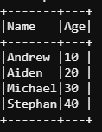
Using createDataFrame
Example:
empDF = spark.createDataFrame(rdd, schema = ["Name", "Age"])
empDF.show(truncate=False)
DataFrame

Slide 45
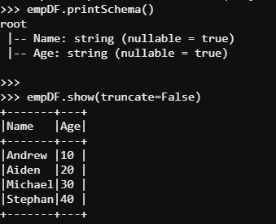
Using createDataFrame with StructType
Example:
from pyspark.sql.types import StructType,StructField, StringType
empSchema = StructType([
StructField('Name', StringType(), True),
StructField('Age', StringType(), True)
])
empDF = spark.createDataFrame(rdd, schema = empSchema)
empDF.printSchema()
empDF.show(truncate=False)
DataFrame

Slide 46
PySpark DataFrames

Slide 47
Creating PySpark DataFrames
SparkSession.createDataFrame(data, schema=None, samplingRatio=None, verifySchema=True) can be used to create a dataFrame in Pyspark where:
Data is an RDD of any kind of SQL data representation.
Schema can be provided using a list of column names. The type information for each column is inferred from the data.
When schema is none, PySpark tries to infer the schema from the data itself. In this scenario, data should be an RDD of type row named tuple or dictionary.
samplingRatio can be float, optional.
verifySchema verifies data types of every row against schema and is enabled by default.
Notes:
Trainer Notes:
The above method takes the schema argument to specify the schema of the DataFrame.
Schema can be provided using a list of column names. The type information for each column is inferred from the data.
When Schema is None, pyspark try to infer the schema from data itself. In this scenario data should be an RDD of type row, named tuple or dict.
Schema can be provided using pyspark.sql.types.DataType or a datatype string. In this scenario the type should match the real data, otherwise exception will be thrown.

Slide 48
Creating PySpark DataFrames
DataFrame can be created by reading data from multiple file formats.
CSV, JSON
Hive Metastore
RDBMS
RDD
Column 1 | Column 2 | Column 3

Slide 49
PySpark DataFrame from CSV
Step 1: Create a SparkSession
spark = SparkSession \
.builder \
.appName("Scenario1“) \
.getOrCreate()
Step 2: Use SparkSession to read a CSV file
df = spark.read \ .option("delimiter", "\t") \ .option("inferSchema", "true") \
.csv("../data-files/customers-tab-delimited") //HDFS path
Notes:
Trainer Notes:
Explain each mode in detail.

Slide 50
PySpark DataFrame from Parquet
Step 1: Create a SparkSession
spark = SparkSession \
.builder \
.appName("Scenario1“) \
.getOrCreate()
Step 2: Use SparkSession to read a Parquet file
df = spark.read.parquet("../data-files/orders_parquet“) //HDFS path
Notes:
Trainer Notes:
Explain each mode in detail.

Slide 51
PySpark DataFrame from Avro
Step 1: Create a SparkSession
Spark = SparkSession \ .builder \ .appName("Scenario1") \ .config("spark.jars", "../jars/spark-avro_2.12-3.0.0.jar") \ .getOrCreate()
Step 2: Use SparkSession to read an Avro file
df = spark.read.format("avro") \ .load("../data-files/products_avro") //HDFS path
Notes:
Trainer Notes:
Explain each mode in detail.

Slide 52
PySpark DataFrame from JSON
Step 1: Create a SparkSession
spark = SparkSession \ .builder \ .appName("Scenario1") \
.config("spark.jars", "../jars/spark-avro_2.12-3.0.0.jar") \
.getOrCreate()
Step 2: Use SparkSession to read a JSON file
df = spark.read.json("../data-files/categories_json") //HDFS path
df = spark.read.format('org.apache.spark.sql.json') \.load("../data-files/categories_json")
Notes:
Trainer Notes:
Explain each mode in detail.

Slide 53
Spark-Hive Integration

Slide 54
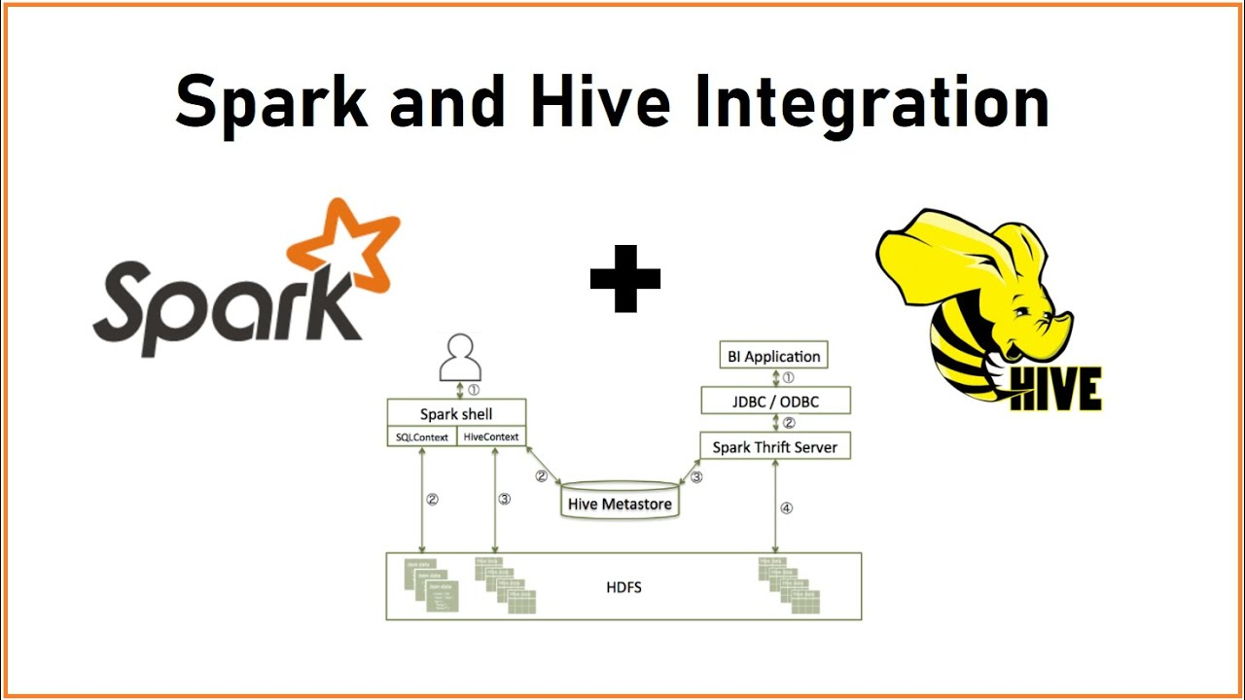
Spark-Hive Integration
We need to call integration of hive with spark to leverage the current tables produced in hive.
To do this, we need the following integration points:
HiveContext: It is a superset of the SQLContext which supports writing queries using the HiveQL parser, access to Hive UDFs, and the ability to read data from Hive tables.
Metastore URI: It confirms the location of the metastore which can be used by spark. This is the main integration point.
Read Data: As the DataFrame is created, we can directly call the table from spark SQL.

Slide 55
Spark-Hive Integration
Libraries required
from pyspark import SparkContext, SparkConf
from pyspark.sql import SparkSession, HiveContext
Set Hive metastore uri
sparkSession = (SparkSession.builder.appName('spark-
hive').enableHiveSupport().getOrCreate())
Read a table from Hive
df_load = sparkSession.sql('SELECT * FROM myTable’)
df_load.show()
Write a table
into Hive
df.write.saveAsTable('myHiveTable')
Notes:
Trainer Notes:
We need to call integration of hive with spark to leverage the current tables produced in hive.
To do this we need below integration points:
HiveContext: HiveContext is a super set of the SQLContext which supports writing queries using the HiveQL parser, access to Hive UDFs, and the ability to read data from Hive tables.
Metastore URI: It confirms the location of the metastore which can be used by spark. This is the main integration point.
Read Data: As the DataFrame is created we can directly call table from spark SQL.

Slide 56
Assisted Practice 16.1: Create DataFrame Using PySpark to Process Records
Duration: 10 Minutes
Problem Scenario: Create a PySpark DataFrame to filter 10 records from a real-world retail business dataset
Objective: To utilize a PySpark DataFrame for reading data from HDFS and filtering only complete orders
Dataset to be Used: order_parquet
Notes:
Trainer Notes:
Perform each step along with the learner.

Slide 57
Assisted Practice 16.1: Create DataFrame Using PySpark to Process Records
Duration: 10 Minutes
Steps Overview:
Step 1: Download the dataset from the Reference Materials section and upload it into the HDFS using Hue
Step 2: Login into the Web desktop and open the PySpark shell
Step 3: Import functions as F from pyspark.sql
Step 4: As a PySpark DataFrame, read the order_parquet data from HDFS
Step 5: Get data for orders marked as COMPLETE
Step 6: Filter the data to display 10 records of COMPLETE orders
Note: The solution to this assisted practice is provided under the Reference Materials section.
Notes:
Trainer Notes:
Perform each step along with the learner.

Slide 58
Assisted Practice 16.2: UDF with DataFrame
Duration: 10 Minutes
Problem Scenario: Create a DataFrame and define a Python function to convert it into a User Defined Function (UDF)
Objective: In this demonstration, you will create a built-in function using UDF to convert the first letter of every word into uppercase
Steps Overview:
Step 1: Import required packages and create a DataFrame with two columns (S_No, Name)
Step 2: Create a function convertCase(), which will convert the first letter of every word into a capital letter
Step 3: Convert a Python function to PySpark UDF
Step 4: Apply the convertUDF function on a DataFrame column as a built-in function
Note: The solution to this assisted practice is provided under the Reference Materials section.
Notes:
Trainer Notes:
Perform each step along with the learner.

Slide 59
Spark SQL was developed to address the shortcomings of Apache hive.
User-Defined Functions (UDFs) allow to create a custom function and utilize it in SQL.
A DataFrame is a distributed collection of data in which the data is
grouped into named columns.
The Catalyst optimizer is an Apache Spark component that optimizes structural queries written in SQL, DataFrame, and Dataset API structural queries.

Slide 61
Which of the following are the components of the Spark project?
1
Spark Core and RDDs
Spark SQL
Spark Streaming
All of the above

Slide 62
Which of the following are the components of the Spark project?
1
Spark Core and RDDs
Spark SQL
Spark Streaming
All of the above
D
Spark Core and RDDs, Spark SQL, and Spark Streaming are some of the components of Spark project.

Slide 63
“Spark driver runs on the host from where the job is submitted”. Which mode is
being talked here?
2
Client Mode
Cluster Mode
Standalone Mode
Mesos

Slide 64
“Spark driver runs on the host from where the job is submitted”. Which mode is
being talked here?
2
Client Mode
Cluster Mode
Standalone Mode
Mesos
A
In client mode, the driver is launched directly within the spark-submit process which acts as a client to the cluster. The input and output of the application is attached to the console.

Slide 65
Which of the following are the supported Cluster Managers?
3
Standalone
Apache Mesos
Hadoop Yarn
All of the above

Slide 66
Which of the following are the supported Cluster Managers?
3
Standalone
Apache Mesos
Hadoop Yarn
All of the above
D
Standalone, Apache Mesos, and Hadoop Yarn are all supported Cluster Managers.

Slide 67
Suppose you want to run spark job on production server to gather data of all those
bike station where count of vehicles is greater than 10 at any time. The job will be
submitted to YARN via :
4
Spark shell console
SparkR way
Jar file using Spark-Submit
Executable file via Spark-Shell

Slide 68
Suppose you want to run spark job on production server to gather data of all those
bike station where count of vehicles is greater than 10 at any time. The job will be
submitted to YARN via :
4
Spark shell console
SparkR way
Jar file using Spark-Submit
Executable file via Spark-Shell
C
The Spark-Submit script in Spark's bin directory is used to launch applications on a cluster. It can use all of Spark’s supported cluster managers through a uniform interface so to configure application for each one is not required.

Slide 69
What are the functions of Spark SQL?
5
It provides the DataFrame API
It defines DataFrames containing rows and columns
It provides the Catalyst Optimizer along with SQL engine and CLI
All of the above

Slide 70
What are the functions of Spark SQL?
5
It provides the DataFrame API
It defines DataFrames containing rows and columns
It provides the Catalyst Optimizer along with SQL engine and CLI
All of the above
A
Spark SQL provides the DataFrame API, It also defines DataFrames containing rows and columns, and provides the Catalyst Optimizer along with SQL engine and CLI.

Slide 71
Lesson-End Project: Retail Business Analytics
Problem Scenario:
Retail businesses sell items or services to customers for their consumption, usage, or pleasure. They typically sell items and services in-store, but some items are sold online or over the phone, and then shipped to the customer. Examples of retail businesses include clothing, drug, grocery, and convenience stores. As a Spark developer, you are required to find the fraud transactions per month with the number of orders and count.
Objective: The objective is to analyze the order table and perform the analytics using PySpark
Dataset to be Used: part-m-00000
Notes:
Trainer Notes:
Explain the problem statement
Ask the learners to finish the activity before the start of the next session
3. Resolve all queries and doubts raised by learners

Slide 72
Lesson-End Project: Retail Business Analytics
Steps Overview:
Download the dataset from the Reference Materials section
In HUE, make a folder called data-files and within it, create a folder called orders. Upload part-m-00000 into orders
Open the PySpark shell in Web desktop
Read the data in PySpark Shell
Create a program to find all fraud transactions where order_status must be equal to SUSPECTED_FRAUD
Use YYYY-MM format for order_date
The output should contain order_date and count, sorted by order_date in descending order

Slide 73
Thank You

